Slide 1
Machine Learning for Networking
Nick Feamster

Slide 2
Part 1: Machine Learning 101

Slide 3
Recommended Books
Machine Learning with Python Cookbook (Albon)
Good book for tinkering with ML concepts in Python
Elements of Statistical Learning (Hastie)
Machine learning fundamentals
Data Science for Business (Provost and Fawcett)
Good practical introduction to ML
Machine Learning (Peter Flach)
Good introduction to algorithms/models/methods
Deep Learning (Goodfellow)
https://github.com/janishar/mit-deep-learning-book-pdf
Good comprehensive intro to deep learning

Slide 4
Online Resources
Machine Learning Crash Course
https://developers.google.com/machine-learning/crash-course/
Introduction to Statistical Learning
Book: http://www-bcf.usc.edu/~gareth/ISL/
Videos:https://www.youtube.com/user/dataschool/playlists?shelf_id=4&sort=dd&view=50
Mining Massive Datasets
http://www.mmds.org/
Good set of videos on ML: https://classroom.udacity.com/courses/ud262

Slide 5
ML’s Relationship to Other Domains
Computer Science
Applied machine learning is a sub-domain of computer science
ML applications to many areas (vision, security, etc.)
CS systems also designed to support ML algorithms
Statistics
Statistics ~ ML, but focus is often modeling
Social Sciences
Economists focus on modeling, often models are regression-based (e.g., linear regression)

Slide 6
Related Skills
Skills
Computer Science & Programming
Statistics
Social Sciences
Experimental Design
Communication
Problem Formulation
Ethics & Legal Issues

Slide 7
What is Machine Learning?
“A computer program is said to learn from experience E with respect to some task T and some performance measure P, if its performance on T, as measured by P, improves with experience E.”

Slide 8
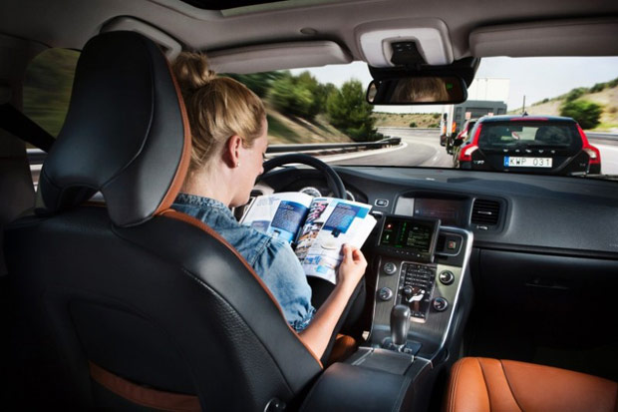
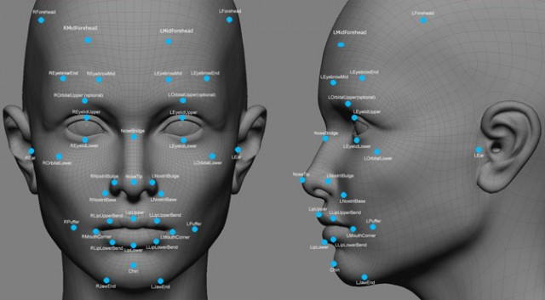

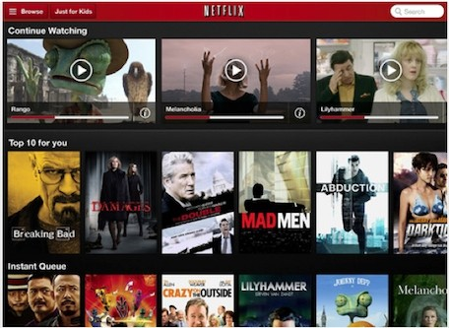

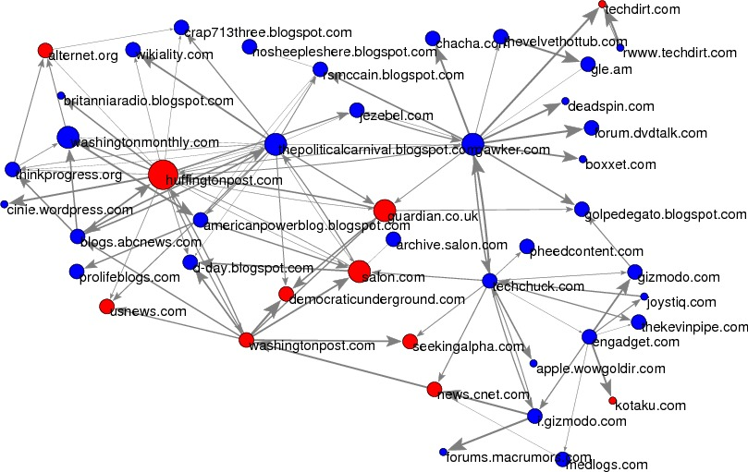
Notes:
Usps
Amazon/netflix - recommender
Advertising
Health
Autonomous cars

Slide 9
Why Machine Learning?
Goal: System that is adaptive (able to respond to unseen inputs), cost-effective, scalable.
Rule-based systems are rigid and expensive.
Often doesn’t work well on unseen inputs
ML works well when lots of data is available to “train” the system.

Slide 10
Machine Learning Benefits
The only way to solve problems
Simple thresholds
Magic (making predictions based on patterns in data)
Data-Agnostic (requires seeing lots of data; subject to bias)
Notes:
Needs to be combined with other methods
Features are important. The expert still needs to do work in defining the problem, generating features, selecting models, evaluation criteria
Without good data, models are bad. Bias, size, etc.

Slide 11
Types of ML Tasks
Description (Understand the past)
Detection (Anomalies, Events, Patterns)
Prediction (Predict the Future)
Behavior Change (Causal Inference)

Slide 12
“Data Science” Pipeline

Slide 13
ML Process
Problem Formulation
Process Data
Explore Data
Deeper Analysis (Modeling)
Store Data
Evaluate
Deploy and Maintain
Get Data
Link Data

Slide 14
Two Types of Machine Learning
2. Supervised: Making predictons of labeled data based on past examples.
Classification
Regression
…
1. Unsupervised
Discover patterns in unlabeled data.
Clustering
Dimensionality Reduction
(e.g., PCA)
…
“Weakly” supervised

Slide 15
Unsupervised Learning
No outcome or dependent variable is present
Goal is exploration, understanding historical data, finding patterns and/or groups in the data
Examples
Clustering (cluster analysis)
Principal Component Analysis
Association Rules (bread and jam)

Slide 16
Supervised Learning
y
= f( )
X
output
“Learned”
function
Features/Predictors
future/generalization
Training or Learning: Find an f that minimizes error in recovering y
Slide credit: L. Lazebnik

Slide 17
Supervised Learning
y
= f( )
X
output
“Learned”
function
Features/variables/inputs/predictors/independent variables
Training: Given a training set of labeled examples {(x₁,y₁), …, (x_{N},y_{N})}, estimate the prediction function f that minimizes future generalization (out of sample) error
Scoring/Testing: apply f to a new example x and output the predicted value y = f(x)

Slide 18
Supervised Learning Steps
Label the data (outcomes/targets)
Define and create Features (predictors)
Create training and validation sets
Train model(s) on training set
Test/validate model(s) on validation set

Slide 19
Learning Steps
Training
Features
Training
Learned model
Training Data
Targets/Outcomes

Slide 20
Testing Steps
Testing/Validation
Apply Model
Features
Predictions
Test Data
Compare
Labels
Metrics (e.g., error)

Slide 21
Supervised Learning Methods
Logistic Regression
Linear Regression
Nearest Neighbor
Bayes Classifier
Neural Networks
Decision Trees
Support Vector Machines
Ensembles
Bagging
Boosting
Random Forests

Slide 22
Selecting a Method: Considerations
What assumptions does it make about the data?
What is it optimizing for?
How to train it?
What parameters does it have?
How to select those parameters?
How to use it to score new data?
How to interpret the model and the predictions?

Slide 23
Comparing Supervised Learning
Efficiency
training
testing/scoring
Robustness
to noise in the data
to violations of assumptions

Slide 24
Linear Regression

Slide 25
Logistic Regression
Maps x to a 0-1 space

Slide 26
Logistic Regression
Goal: estimate parameters (β_{i}) to estimate log-odds Log (P/ (1– P))
Log (P/ (1– P)) = β₀ + β_{i} X_{i}

Slide 27
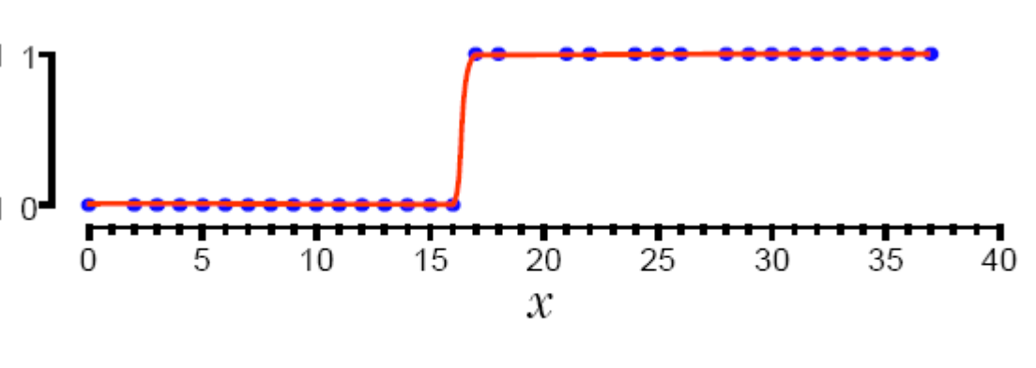
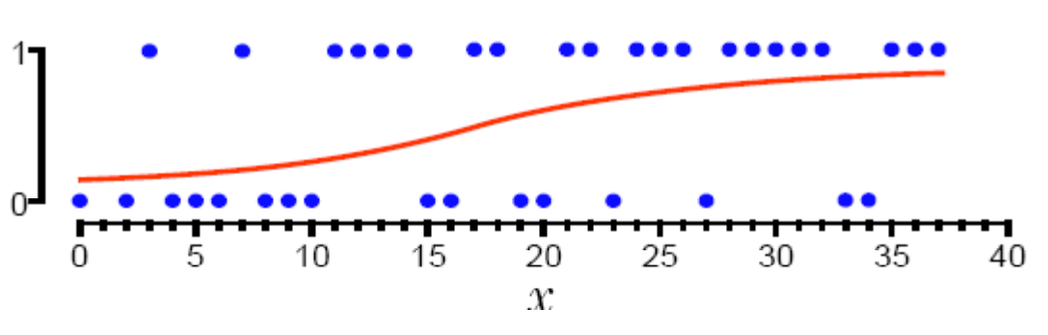
1-Dimensional Decision Boundary

Slide 28
How does Logistic Regression control underfitting and overfitting?

Slide 29
Regularization
A way to reduce overfitting in machine learning models by adding penalties for increasing model complexity
Logistic Regression:
Early stopping
add a penalty term to the cost function based on non-zero coefficients
L1 (Lasso):
L2 (Ridge):

Slide 31
Regularization
What is the impact of L1 (Least Absolute Shrinkage and Selection Operator) ?
What does L2 do?

Slide 32
Data Preparation?
Do we have to do any data prep for logistic regression?

Slide 33
More about Logistic Regression
http://nbviewer.jupyter.org/github/justmarkham/DAT8/blob/master/notebooks/12_logistic_regression.ipynb
Little deeper into Logistic Regression https://www.youtube.com/watch?v=31Q5FGRnxt4&list=PL5-da3qGB5IC4vaDba5ClatUmFppXLAhE
Visualization: https://florianhartl.com/logistic-regression-geometric-intuition.html

Slide 34
Classifiers: Nearest neighbor
x
x
x
o
x
x
x
o
x
o
x
o
o
o
o
New data point
f(x) = label of the training example nearest to x
All we need is a distance function for our inputs
No training required!
Slide credit: L. Lazebnik

Slide 35
K-nearest neighbor
x
x
x
o
x
x
x
+
o
o
x
x
o
o
+
o
o
x2
x1

Slide 36
1-nearest neighbor
x
x
x
o
x
x
x
+
o
o
x
x
o
o
+
o
o
x2
x1

Slide 37
3-nearest neighbor
x
x
x
o
x
x
x
+
o
o
x
x
o
o
+
o
o
x2
x1

Slide 38
5-nearest neighbor
x
x
x
o
x
x
x
+
o
o
x
x
o
o
+
o
o
x2
x1

Slide 39
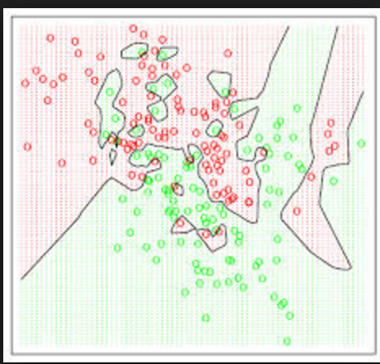
Voronoi Diagrams
Given a set of points, a Voronoi diagram describes the areas that are nearest to any given point.

Slide 42
K-NN: Benefits
Simple to use
Fast to train
Doesn’t make assumptions about data distribution

Slide 43
K-NN: Problems
Need to figure out the right distance function
Slow at scoring/prediction time
Need to store all the data

Slide 44
Probabilistic Classifiers
We want to estimate P(class | data) for every class (and often pick the class with the max p( class | data)
(class == label)

Slide 45
Bayes’ Rule
For a data point d and a class c

Slide 46
Naïve Bayes Classifier
MAP is “maximum a posteriori” = most likely class
Bayes Rule
Dropping the denominator

Slide 47
Naïve Bayes Classifier
Data point d represented as features x1..xn

Slide 48
Naïve Bayes Classifier
O(|X|^{n}•|C|) parameters
How often does this class occur?
Could only be estimated if a very, very large number of training examples was available.
We can just count the relative frequencies in a data set

Slide 49
Naïve Bayes - Independence Assumptions
Conditional Independence: Assume the feature probabilities P(x_{i}|c_{j}) are independent given the class c.

Slide 50
Naïve Bayes Classifier

Slide 51
Pros and Cons
Pros
Fast
No need to fill in missing data
Explicitly handles class priors
Incrementally updated
Cons
Independence assumption may be violated in practice (Features are correlated)
Gives skewed probability estimates when # of features is large. Why?

Slide 52
Questions to think about
When would Naïve Bayes fail?
How would you relax some of the assumptions behind Naïve Bayes to make it more robust?

Slide 53
Factors to consider
Complexity
Model
Tuning
Pre-processing (scaling, missing values, discrete/continuous etc.)
Overfitting/Underfitting
Robustness (to noise)
Interpretability
Training Time
Update Time
Scoring Time

Slide 54
Complexity
Linear vs Non-Linear
Fewer parameters vs more parameters

Slide 55
Overfitting
Reduce Features
Force less complexity
Regularization
Penalize for complexity

Slide 56
Interpretability
To a ML expert?
To a domain expert?
Interpretability of the model vs Interpretability of the predictions

Slide 57
Time
Training
Classifying/Scoring new data
Updating when you get more labels back

Slide 58
Classifier Comparisons
Azure ML Blog Post
Another google doc done by Data School (not all the information in there is “correct”)
Sklearn map
Comparison Methodology
http://jmlr.org/papers/volume15/delgado14a/delgado14a.pdf
http://citeseerx.ist.psu.edu/viewdoc/summary?doi=10.1.1.122.5901

Slide 59
Unsupervised Learning

Slide 60
Types of Learning
Unsupervised
“Weakly” supervised
Fully supervised
Clustering
PCA
…
Anomaly Detection
Classification
Binary, multi-class, hierarchical, sequential
Regression

Slide 61
Unsupervised Learning
No outcome or dependent variable is present
Goal is exploration, understanding historical data, finding patterns and/or groups in the data
Examples
Clustering (cluster analysis)
Principal Component Analysis
Association Rules

Slide 62
Clustering
A good clustering method will produce clusters with
High intra-cluster similarity
Low inter-cluster similarity
K-Means is the simplest and the most common algorithm
Notes:
http://stanford.edu/class/ee103/visualizations/kmeans/kmeans.html

Slide 63
K-means example, step 1
k₁
Y
Pick 3
initial
cluster
centers
(randomly)
k₂
k₃
X

Slide 64
K-means example, step 2
k₁
Y
k₂
Assign
each point
to the closest
cluster
center
k₃
X

Slide 65
K-means example, step 3
k₁
k₁
Y
Move
each cluster center
to the mean
of each cluster
k₂
k₃
k₂
k₃
X

Slide 66
K-means example, step 4
Reassign
points
closest to a different new cluster center
k₁
Y
k₃
k₂
X

Slide 67
K-means example, step 4 …
k₁
Y
Reassign
points
k₃
k₂
X

Slide 68
K-means example, step 4b
k₁
Y
re-compute cluster means
k₃
k₂
X

Slide 69
K-means example, step 5
k₁
Y
k₂
move cluster centers to cluster means
k₃
X

Slide 70
K-means algorithm
Given k, the k-means algorithm works as follows:
Randomly choose k data points (seeds) to be the initial centroids (cluster centers)
Assign each data point to the closest centroid
Re-compute the centroids using the current cluster memberships.
If a convergence criterion is not met, go to 2).

Slide 71
Stopping/convergence criterion
no (or minimum) re-assignments of data points to different clusters,
no (or minimum) change of centroids, or
minimum decrease in the sum of squared error (SSE),
C_{i} is the jth cluster, m_{j} is the centroid of cluster C_{j} (the mean vector of all the data points in C_{j}), and dist(x, m_{j}) is the distance between data point x and centroid m_{j}.

Slide 72
Part 2: Machine Learning for Networking

Slide 73
Network Management: Measure, Model, Control
Network-wide
“what if” model (analytical, statistical)
Indirect Inference
Protocol modeling
Statistical inference
Topology/
Configuration
Failures/ Attacks
Traffic Demands
Changes to
the network
measure
control
Operational Network

Slide 74
Predictive Analytics for Network Security

Slide 75
Many Cybersecurity Problems Involve Large-Scale Predictive Analytics
Rare events
Time-series analysis
Analysis of heterogenous data
Analysis of communication graphs
Need to analyze data in real time
Need to detect outliers

Slide 76
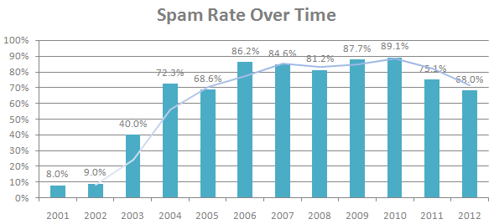
Unwanted Traffic: Spam
70-90% of all email traffic is spam
(Sources: Symantec 2010, MAAWG 2011, Symantec 2013)

Slide 77



Conventional Approach #1: Content Filters
PDFs
Excel sheets
Images
...even mp3s!

Slide 78
Conventional Approach #2: IP Addresses
Received: from mail-ew0-f217.google.com (mail-ew0-f217.google.com [209.85.219.217])
by mail.gtnoise.net (Postfix) with ESMTP id 2A6EBC94A1
for <feamster@gtnoise.net>; Fri, 21 Oct 2011 10:08:24 -0400 (EDT)
Problem: IP addresses are ephemeral
Every day, 10% of senders are from previously unseen IP addresses
Possible causes
Dynamic addressing
New infections

Slide 79








A Lot Happens Before Spam is Sent!
Time
Distribute spam messages
Maintain hosting infrastructure
Acquire network resources
DNS server
Register .com domains
Botnet
Web server
Registrar
Registry
ICANN
Spam message
Spam-advertised page

Slide 80
Predictive Analytics: Detection Based on Network-Level Behavior
Filter email based on how it is sent, (in addition to simply what is sent and who sent it).
First Step: Define Behaviors (In other words, What’s different about spammers?)
Agility. Spammers need to move to escape detection.
Exposure. Spammer sending behavior differs from normal user behavior.
Coordination. Spammers behave like each other.

Slide 81
Predicting Anomalous Behavior
Agility: Spammers must escape detection
Understanding network-level behavior
Challenge: Detecting agility (BGP, DNS)
Exposure: Spammers behave differently
Supervised learning based on features
Challenge: Which features to use?
Coordination: Spammers behave like each other
Clustering based on common behavior
Challenge: What behaviors cluster well?

Slide 82
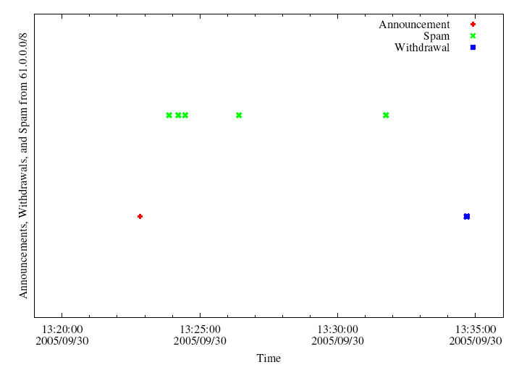
Analysis of Internet Routing Data
Hijack IP address space using BGP
Send spam
Withdraw IP address
A small club of persistent players appears to be using this technique.
Surprise: Common short-lived prefixes are huge!
61.0.0.0/8 4678
66.0.0.0/8 21562
82.0.0.0/8 8717
~ 10 minutes
Somewhere between 1-10% of all spam (some clearly intentional, others “flapping”)
Anirudh Ramachandran and Nick Feamster, “Understanding the Network-Level Behavior of Spammers”, ACM SIGCOMM, September 2006.

Slide 83
Analysis of Sending Patterns
Intuition: Spammers will “cluster” together in IP address space, because many compromised hosts may exist on a single network.
For spammers, k nearest senders are much closer in IP space
Notes:
XXX Fix This XXX

Slide 84
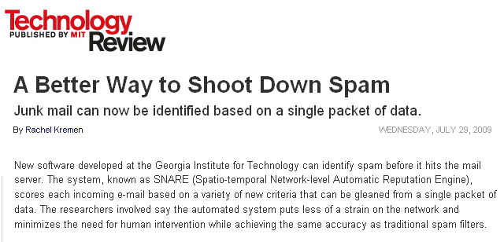

Combining Features: RuleFit
Put features into the RuleFit classifier
10-fold cross validation on one day of query logs from a large spam filtering appliance provider
Using only network-level features
Anirudh Ramachandran, Nick Feamster, and Santosh Vempala, “Filtering Spam with Behavioral Blacklisting”, ACM CCS, 2007
Shuang Hao, Nick Feamster, Alex Gray and Sven Krasser, “SNARE: Spatio-temporal Network-level Automatic Reputation Engine”, USENIX Security, August 2009

Slide 85
Going Back Earlier in Time: Attackers Use the Domain Name System
Attackers use URLs to propagate scams and malware
Idea: Use properties of the registered domains to identify spam, scams, etc.
Problem: How to identify the reputation of a domain?
Previous work relies on observing record changes, which may take time to observe.
Alternative: Look for query patterns within short time of registration.

Slide 86
Predictive Analytics and DNS
Domain registration and resource record establishment occur before attacks take place
DNS infrastructure for scam domains is located in different address space regions and autonomous systems than the infrastructure for legitimate domains.
Early lookup patterns for a newly registered malicious domain differ significantly from the patterns for a legitimate domain
S. Hao, N. Feamster, R. Pandrangi. “Monitoring the Initial DNS Behavior of Malicious Domains”, ACM SIGCOMM Internet Measurement Conference, November 2011.

Slide 87
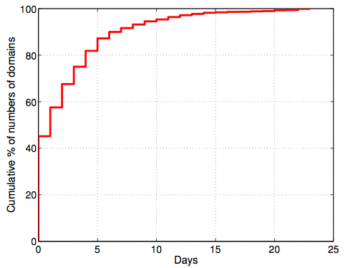
Prediction: Registration Occurs Before Attack!
More than 55% of the malicious domains appeared in spam campaigns more than one day after they were registered.

Slide 88
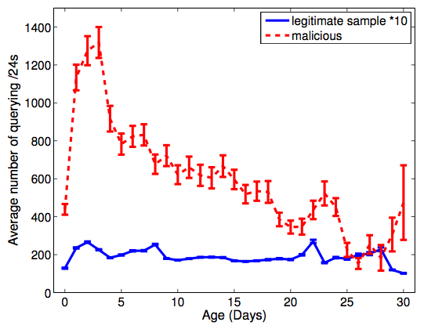
DNS Lookups Precede Attacks!
Queries to the scam domains increased quickly after the domains were registered, and usually reach the peak in the first 3–4 days.

Slide 89
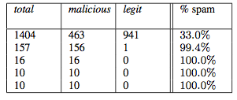
Early Lookup Behavior
Different malicious domains are looked up by similar group of network blocks, which may indicate that they are part of the same spamming campaign.

Slide 90
With Better Data, Possible to Predict Attacks Even Earlier!

Slide 91




DNS Predictive Analytics for Attack Prediction
Proactive Recognition and Elimination of
Domain Abuse at Time-of-Registration
Registration
Use
Detection
Life Cycle

Slide 92
Domain Profile Features
Data from registration event
Registrar, nameserver, character tri-grams, etc.
Includes edit distance to known bad domains
Insertion:
abcdef
abcHdef
Deletion:
abcHdef
abcdef
Substitution:
abCdef
abHdef

Slide 93
Registration History Features
Data from previous registration
Previous registrar, re-registration latency, etc.
Separate reuse into drop-catch and retread
Notes:
BUILD SUSPENSE: How quickly can this happen?

Slide 94
Batch Correlation Features
Data from registrations in same time interval
batch size, rate and types of reuse, etc.
Name cohesiveness using edit distance
Registration Batch
asklenderhome.com
askhomelendersnow.com
stationary.com
asklendershome.com
bestcooks.com
askhomelenders.com
Cohesive
Uncohesive
Notes:
Make clear that batch cohesion is a property of individual domains

Slide 95
Predictive Analytics for Network Performance Management

Slide 96
Network Configuration: Ad Hoc
What happens if I tweak this policy…?
Problems cause downtime
Problems often not immediately apparent
Notes:
Problems may be masked
Not just mistakes
What are the kinds of things that people are likely to want to change:
For example: link provision, flash crowd (simple example)

Slide 97
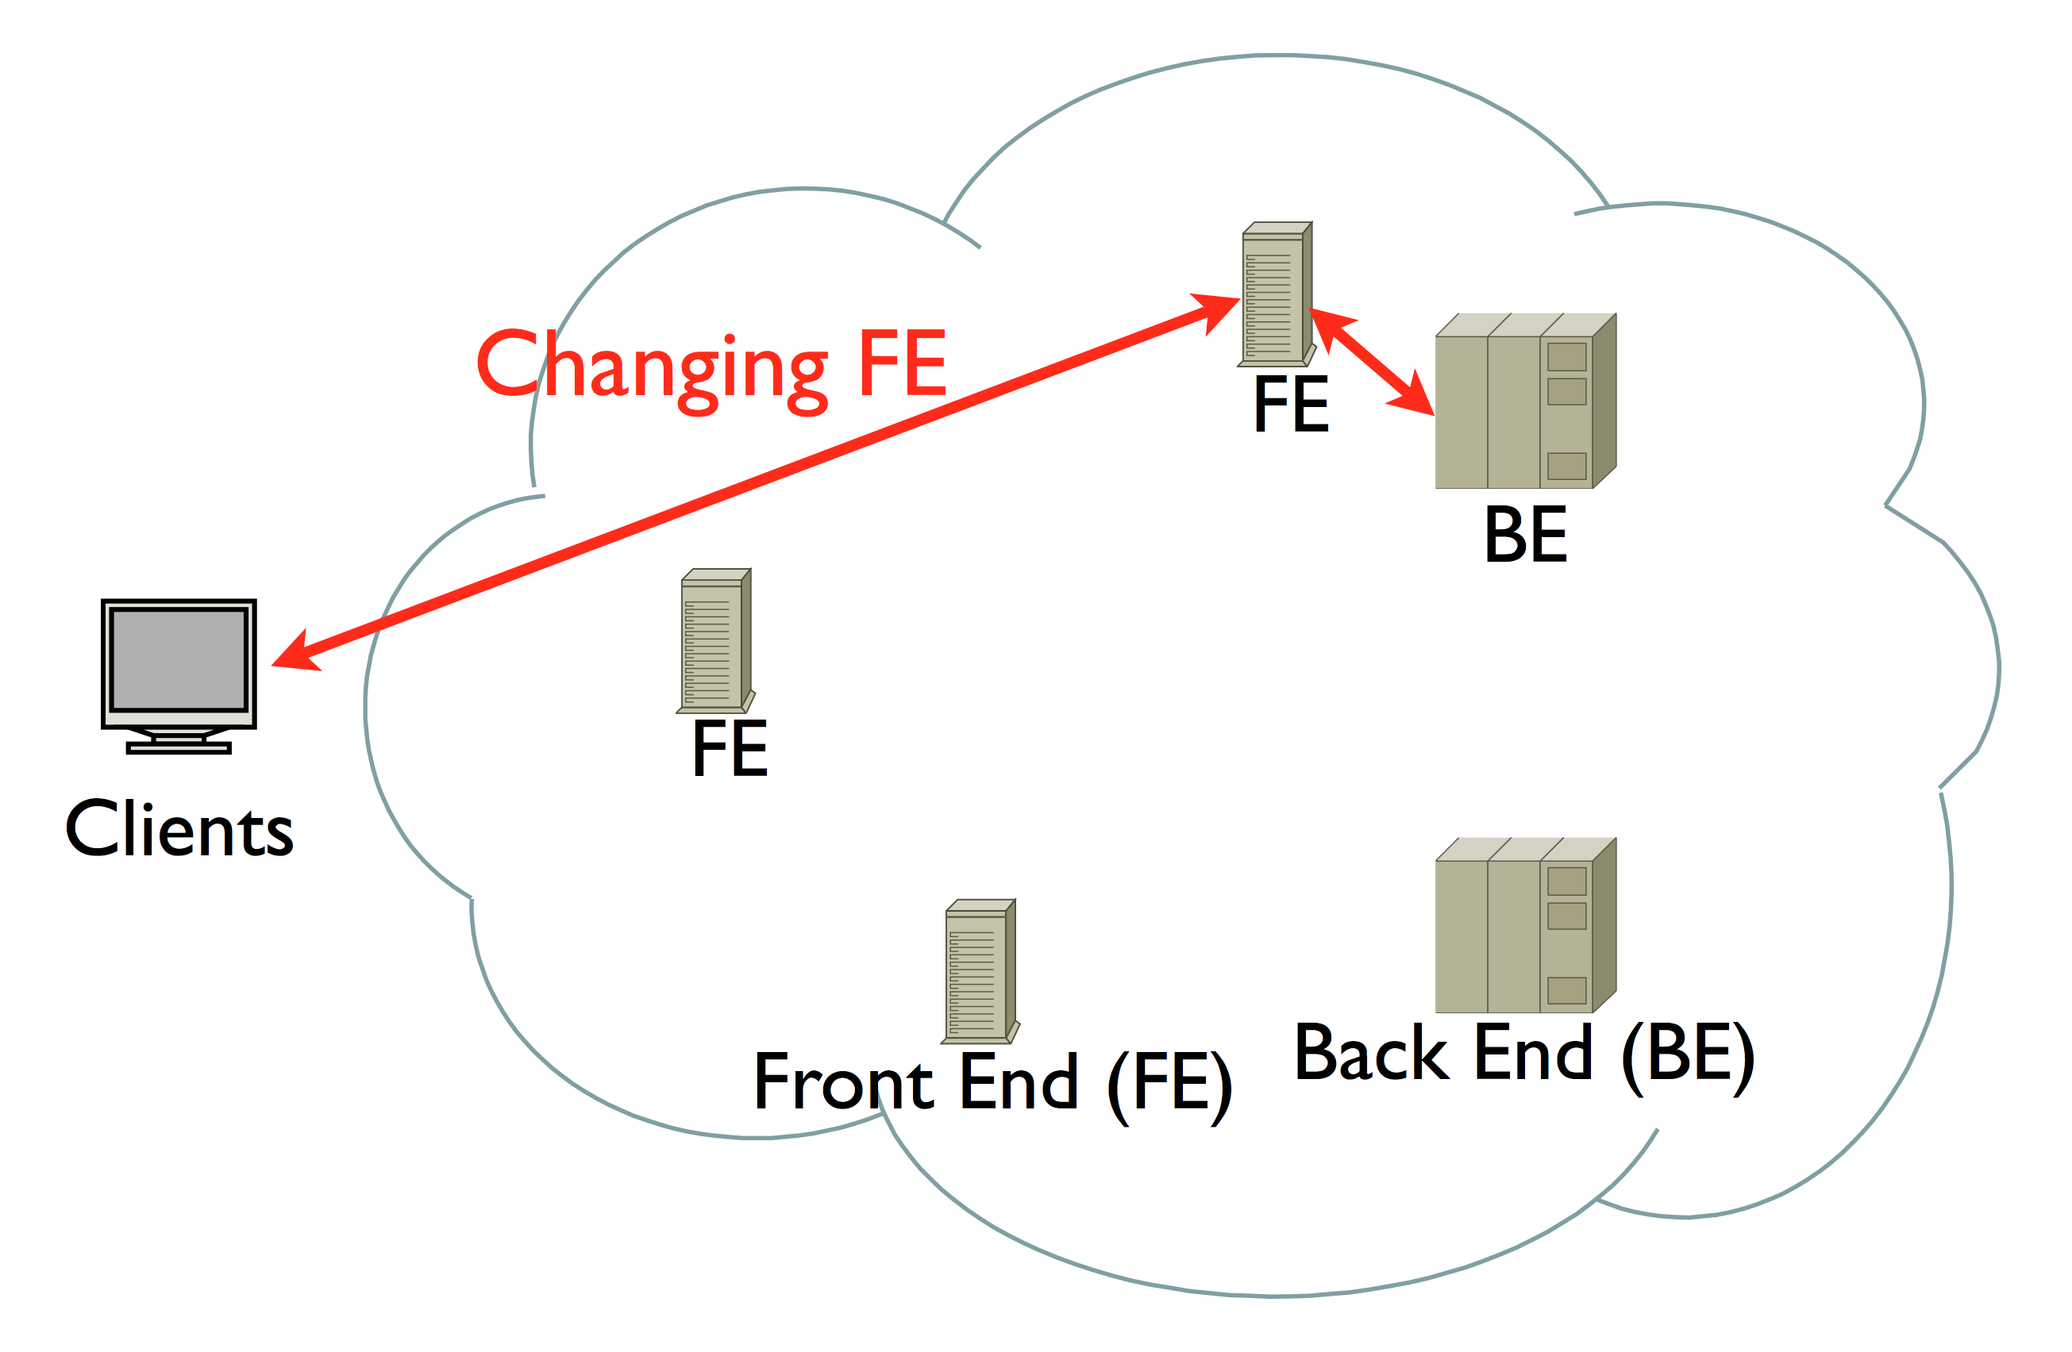
Example “What If” Scenario

Slide 98
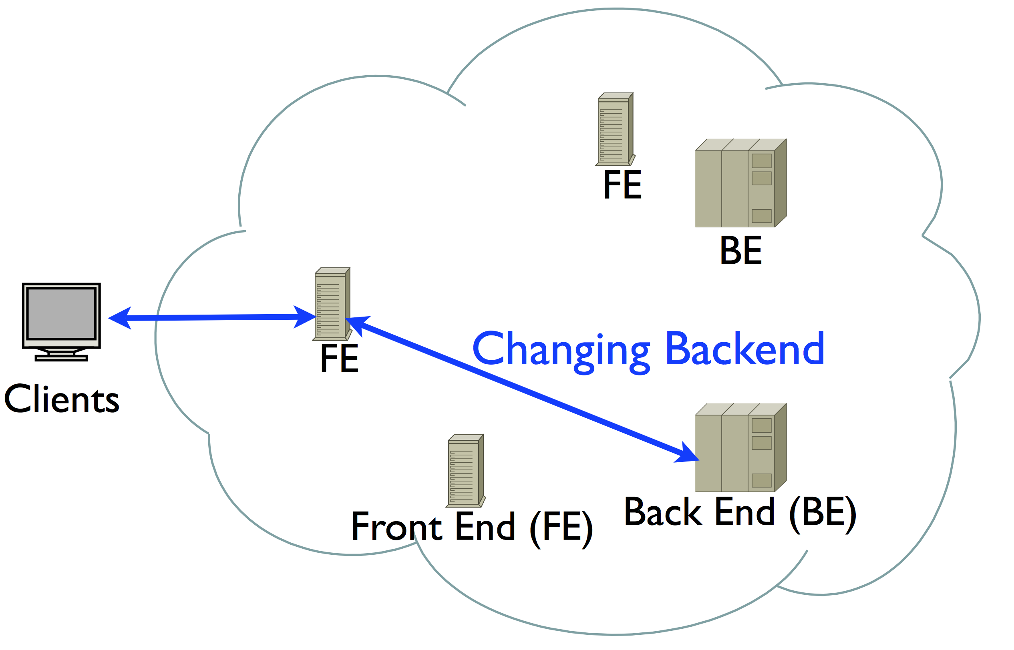
Example “What-If” Scenario
No accurate models for response time
No easy way to specify or evaluate the scenarios

Slide 99
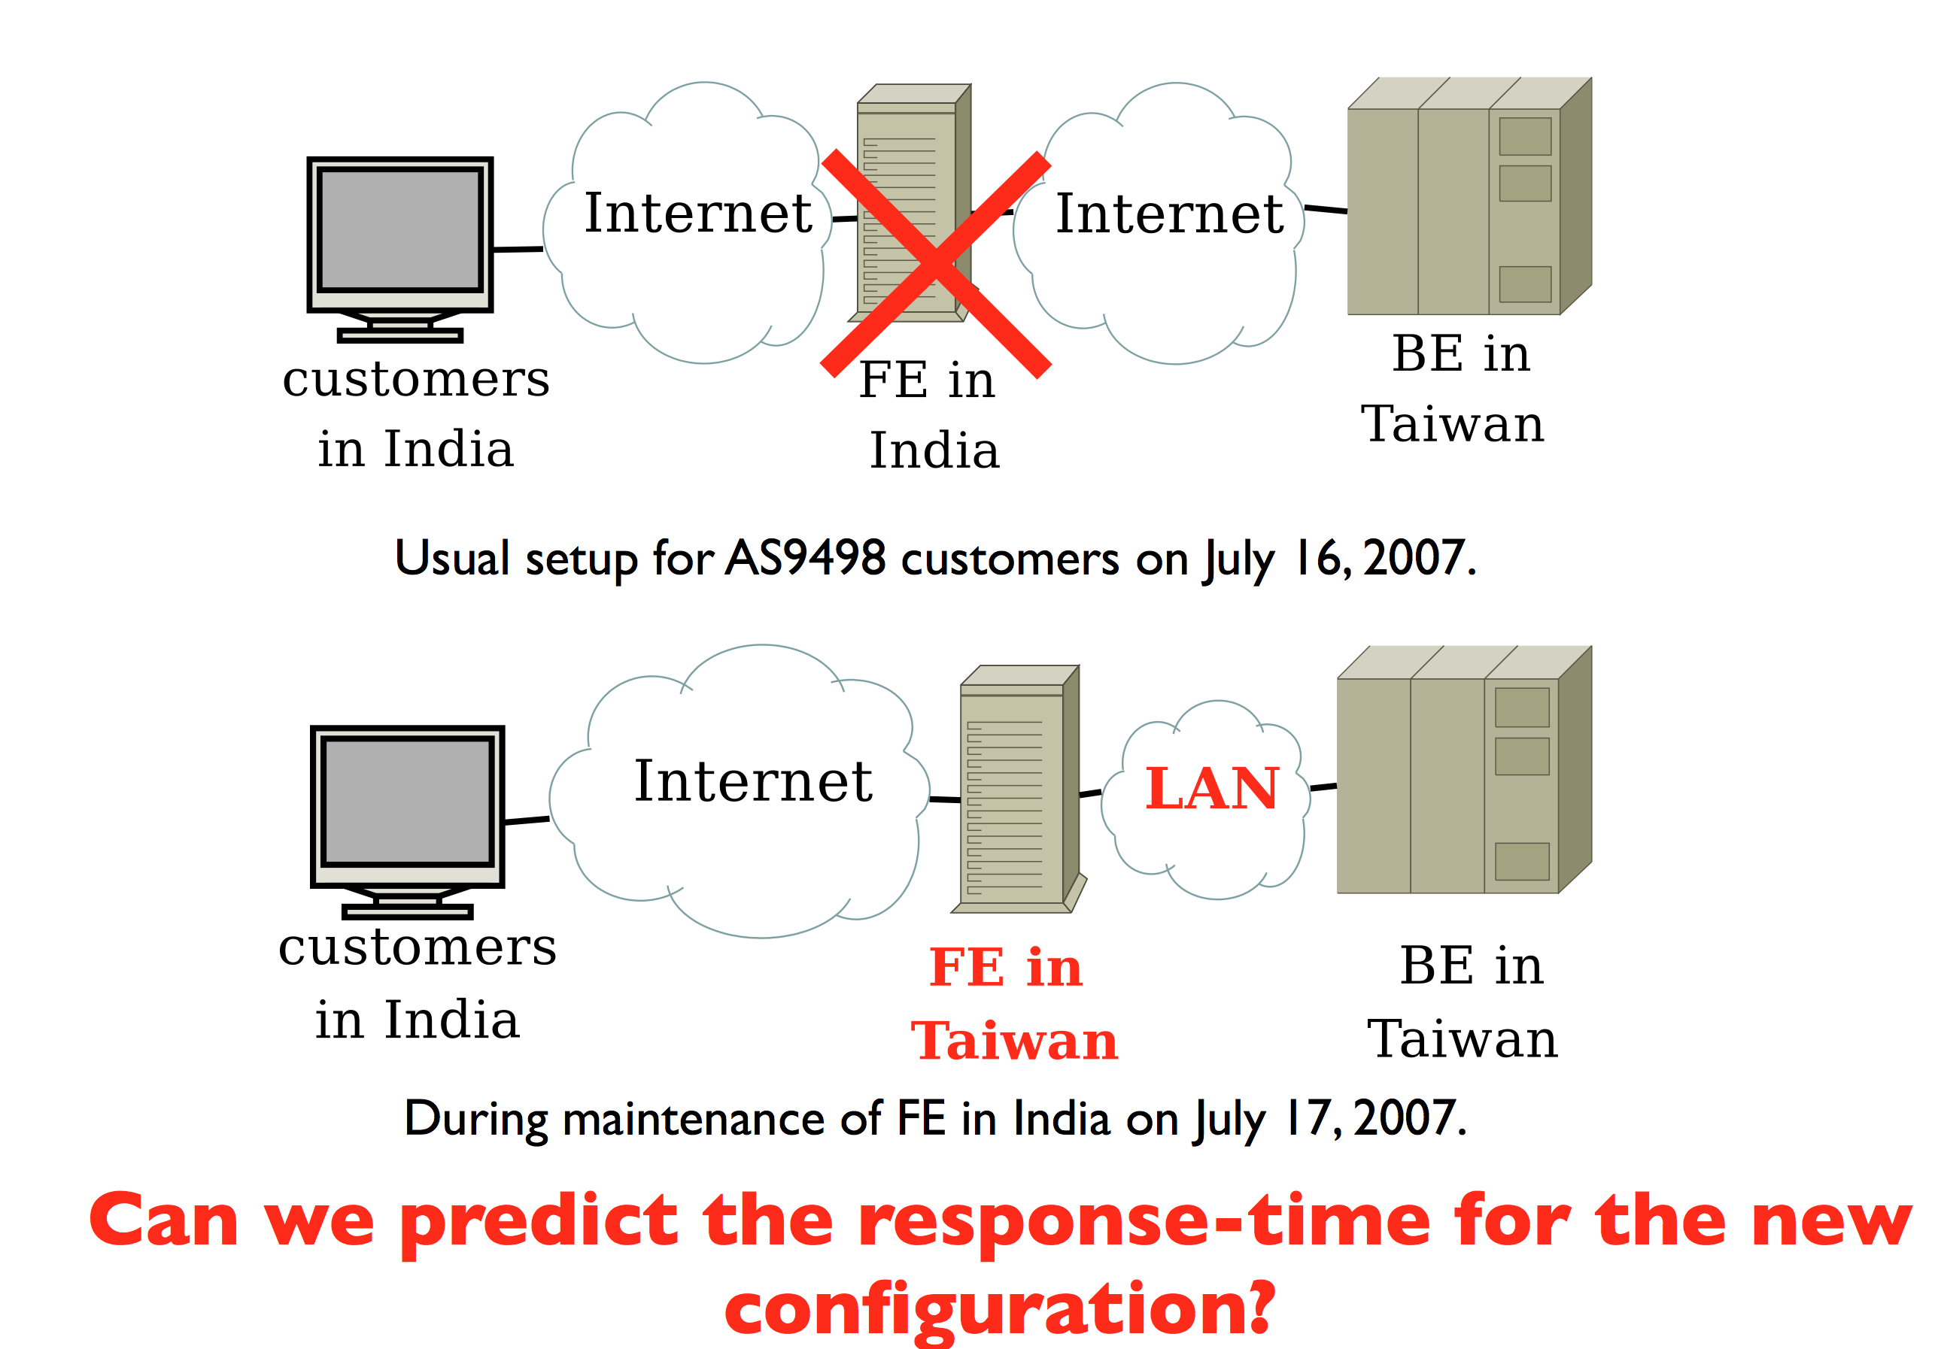
Example: “Draining” a Data Center

Slide 100
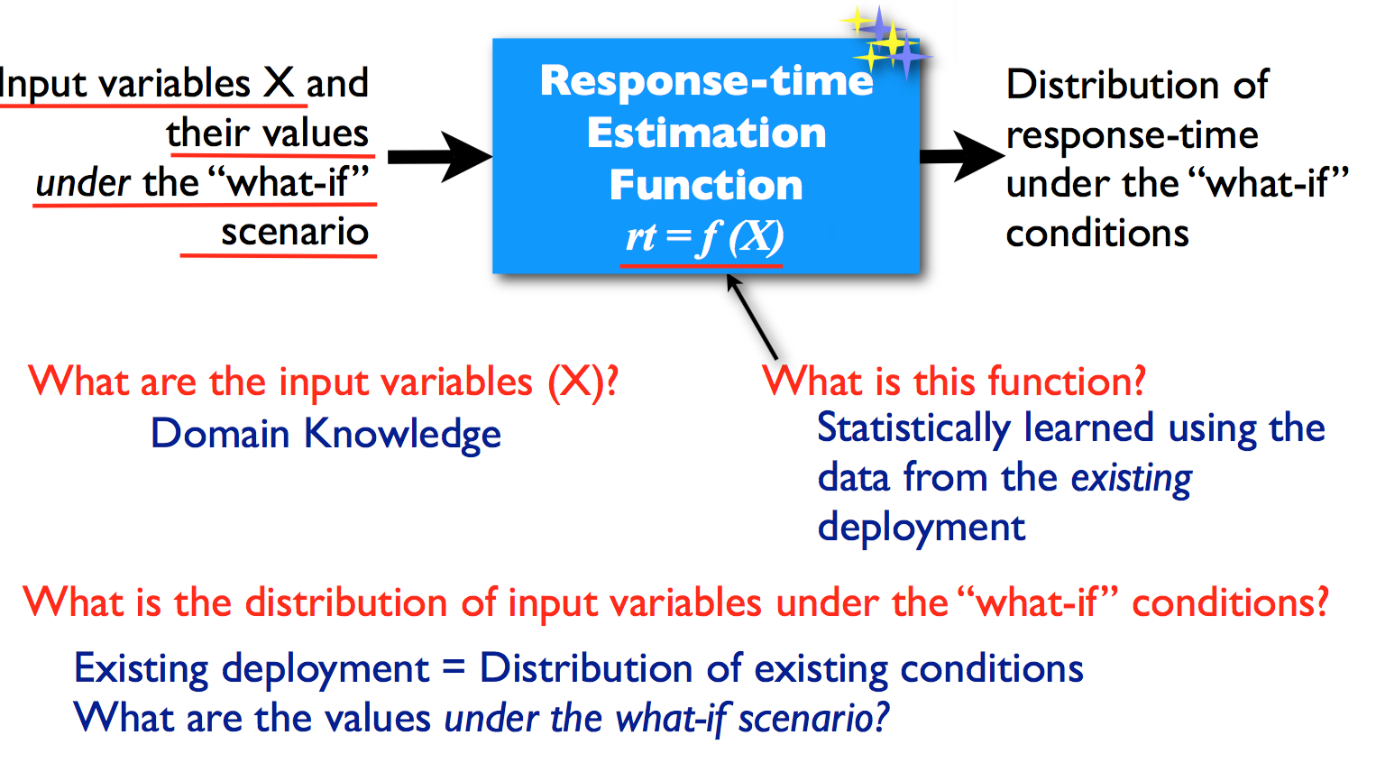
What-If Scenario Evaluation

Slide 101
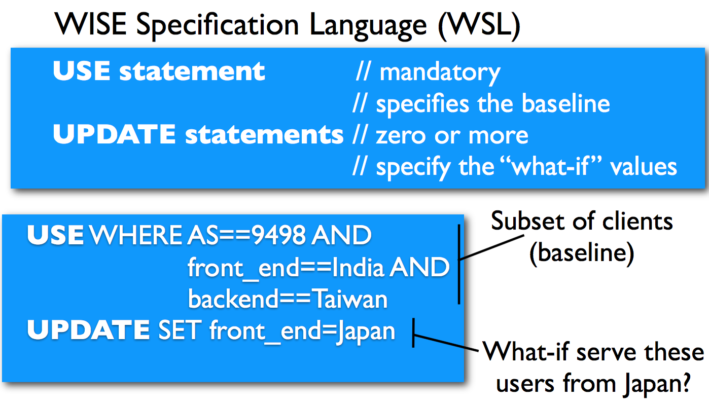
Example What-If Specification

Slide 102
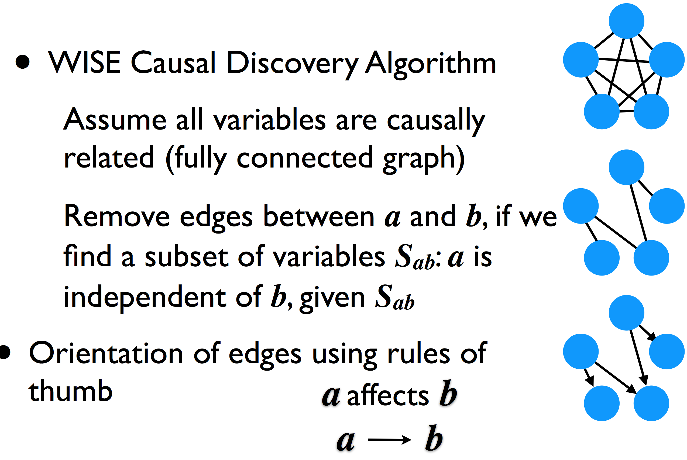
Learning Causal Structure

Slide 103
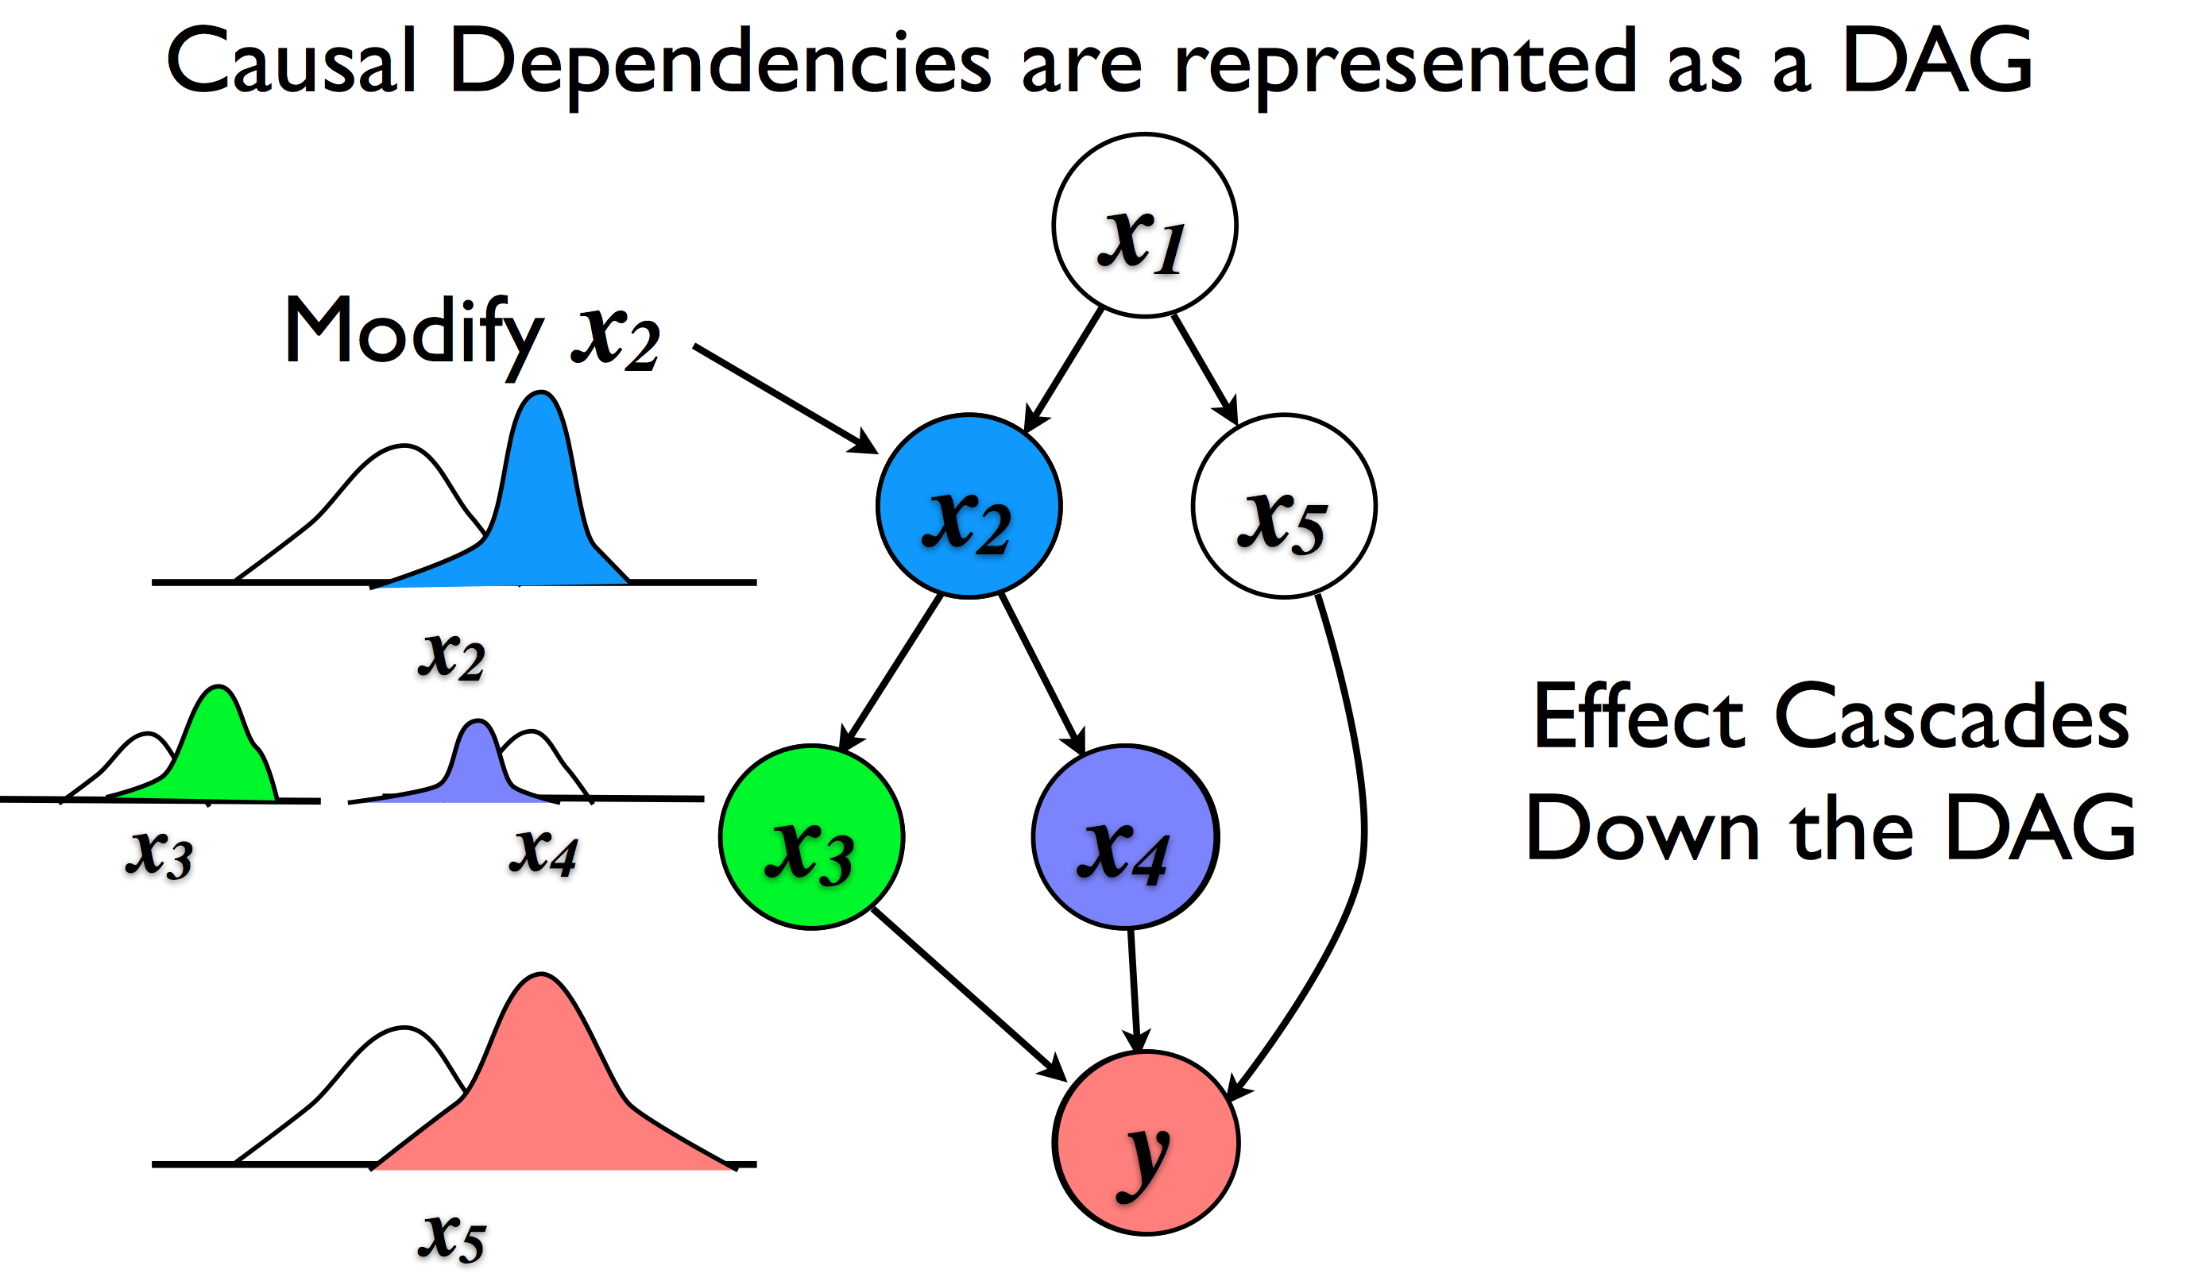
Guiding Transformation

Slide 104
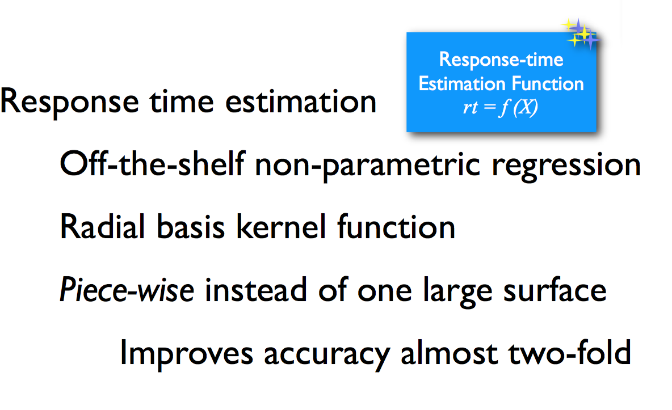
Response-Time Prediction

Slide 105
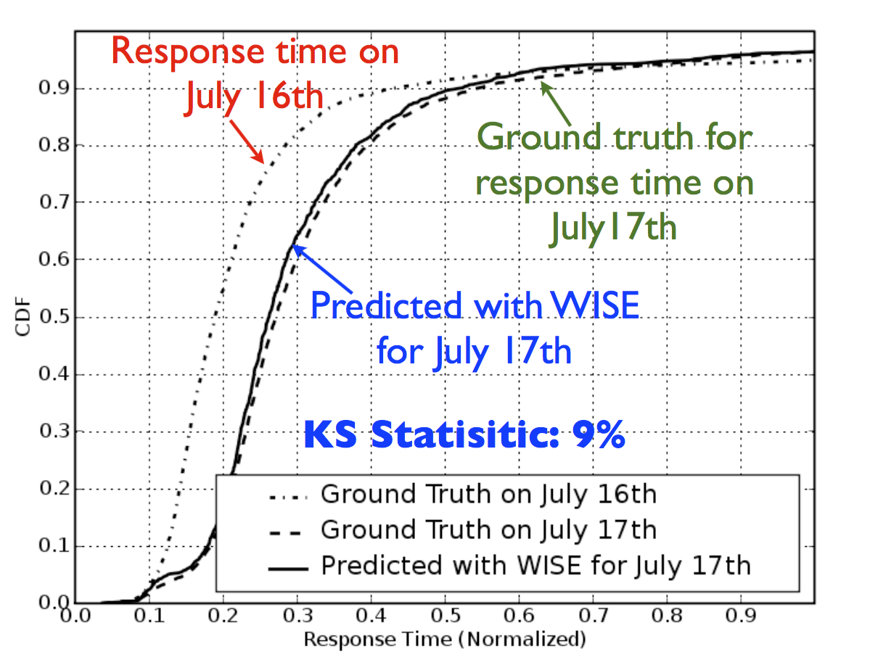
Draining a Data Center: Evaluation

Slide 106
Predictive Analytics: Looking Ahead

Slide 107
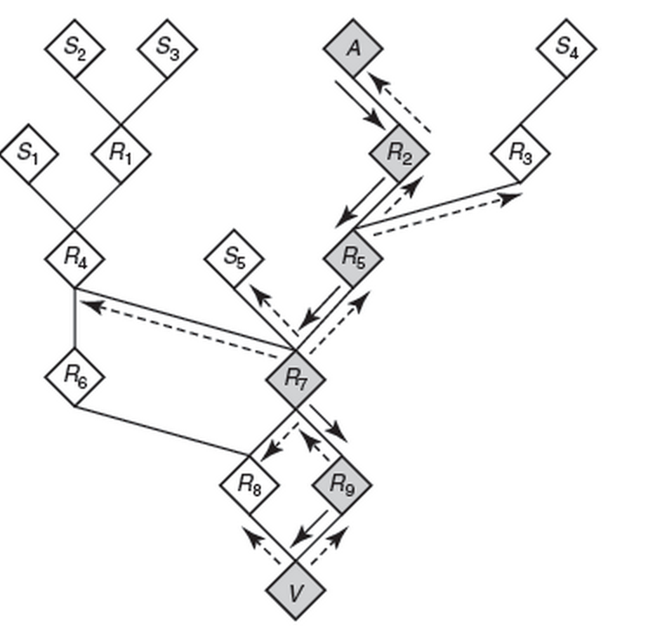
Forensics
Post-intrusion, trace back the source of attack
What happened?
Where did attack come from?
Was any data lost?
Requires extensive logging (prohibitive)
Need to determine when and where to activate intensive logging.
Currently: Difficult

Slide 108
Forensics: Challenges and Opportunities
Problem
More data is better
Need to decide what to capture ahead of time
Identify features (events, network traffic features, etc.) that could trigger more detailed logging
Needs
Detection of rare events
Triggers are rare, but must detect with high accuracy

Slide 109
Application-Layer DoS
Conventional attacks: Volumetric
Send high volumes of traffic towards victim
Modern attacks: Application-layer, low-volume
Exploit network traffic that can consume an aysmmetric amount of resources
SSL handshakes, DNS traffic (“amplification attacks”), Database operations
Challenge: Simply counting traffic volumes will not suffice.

Slide 110
Application-Layer DoS Detection
Goal: Identify network-level traffic characteristics that are suggestive of application-layer DoS.
Opportunities for machine learning
Graph analysis: Detection of abnormal request patterns (domains, clients) at an open resolver
Time-series analysis: Detection of level shifts in DNS queries

Slide 111
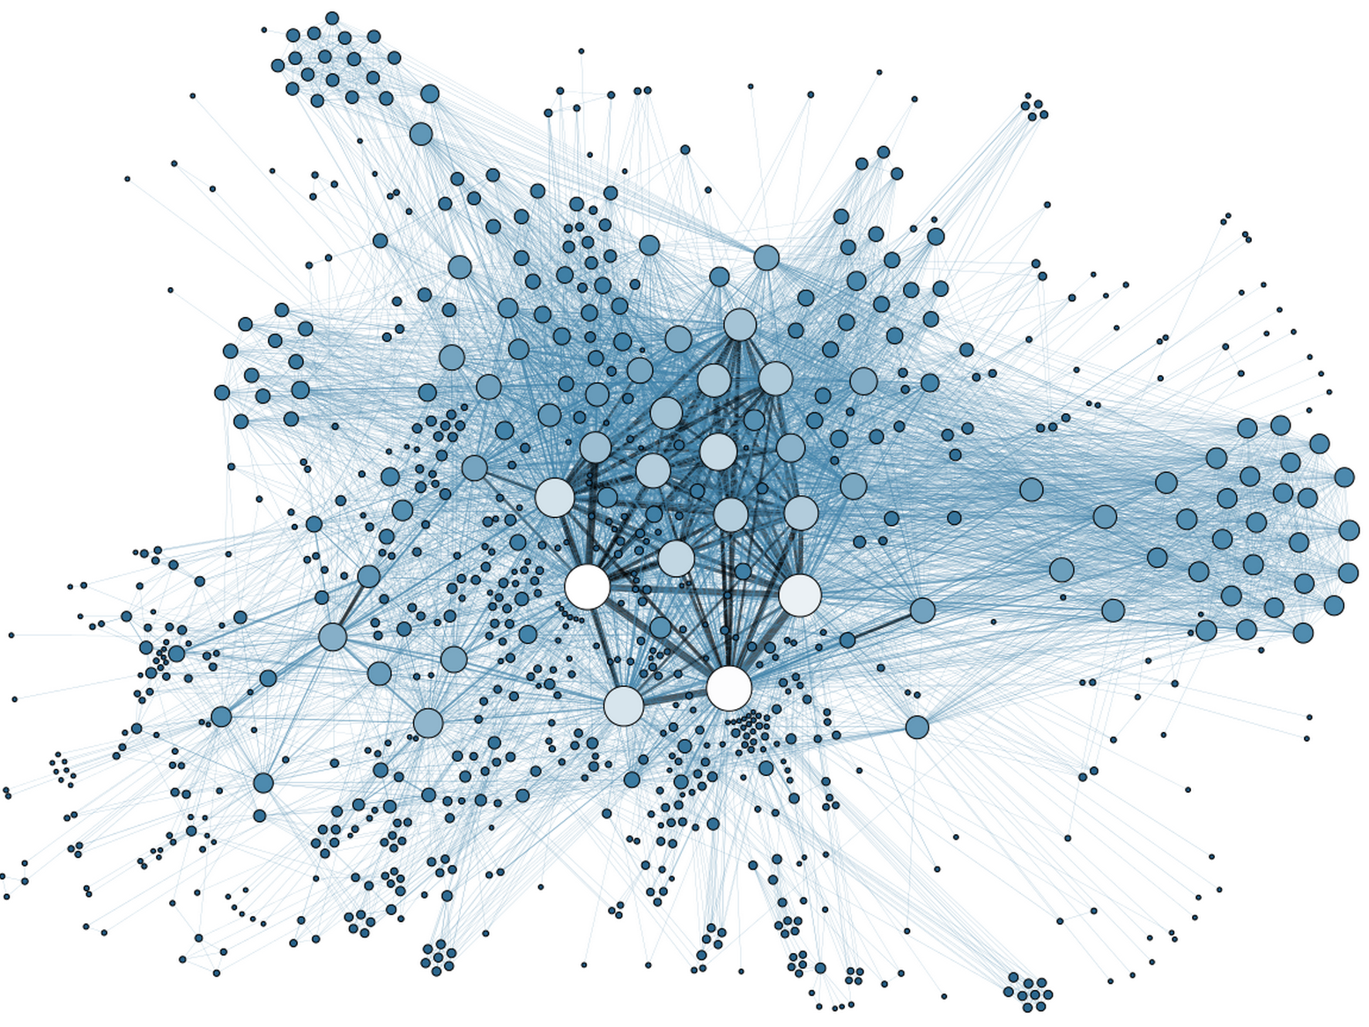
Exfiltration and Insider Threats
Problem
Determine when an employee is a “flight risk” or otherwise a risk for leaking data
Insight: Sometimes flight risk is preceded by changes in communication patterns
Goal: Use data about communication patterns to detect probability of flight risk
Increase defenses (e.g., firewalling) if exfiltration could be predicted
Currently: No good solutions

Slide 112
Exfiltration and Insider Threats
Opportunities for machine learning
Analyzing communication patterns using graph analysis
Detection of rare events
Requires incorporation of many heterogeneous datasets (e.g., communication logs, traffic patterns, etc.)

Slide 113
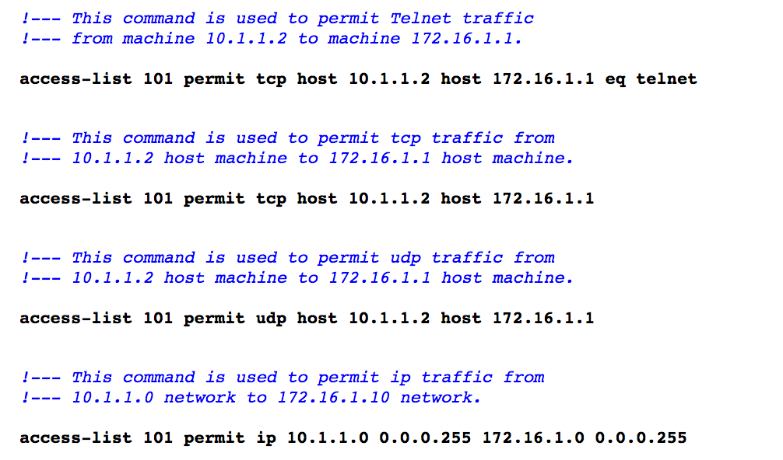
Automating Access Control Lists
Problem
Access control lists need to be continually updated
They can also get overly long if old rules are not removed, consolidated, etc.
Currently: Manual
Need better ways to automate, verify, and optimize

Slide 114
Automating Access Control Lists
Goal: Automate ACL provisioning, removal, optimization
Machine Learning Capabilities
Clustering techniques can identify common idioms
Traffic analysis can help identify “dead code”
Time-dependent dataset analysis can predict which ACLs are needed, and when
Future: Coupling with SDN for “closed loop” automation

Slide 115
ML for Networking: Summary
Many network tasks rely on data analysis, domain knowledge, and predictive analytics
Two main problem areas: Detection and Prediction
Various network management problems
Configuring the network in the first place
Detecting and reacting to faults
Detecting and mitigating attacks
Predicting the effects of configuration change

Slide 116
Measuring Control of Online Speech

Slide 117
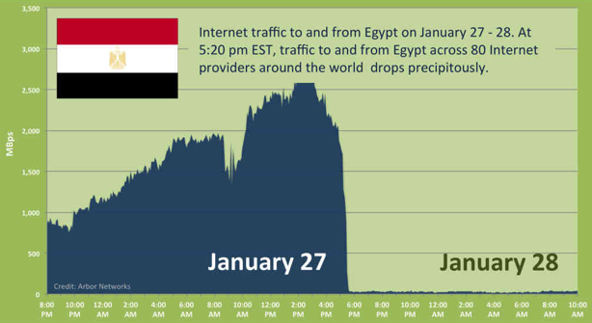
Notes:
2011

Slide 118





Encore: Measure Using Web Browsers
Anecdote
(Twitter censored in Iran)
Custom software
Researcher
Every Web browser is a potential vantage point
Instrumented
Web page
<iframe
src="//encoreenco.re/task.html"
width="0" height="0"
style="display: none">
</iframe>
Volunteer Web site
Vantage points
Censor
Web service

Slide 119
How Encore Works
Origin Web site
GET /
Vantage point
“Can you access http://twitter.com?”
http://encoreenco.re
Web browser
in Iran
Cross-origin
GET /favicon.ico
Measurement target
How?
Censor
http://twitter.com
Burnett, Sam, and Nick Feamster. "Encore: Lightweight measurement of web censorship with cross-origin requests." ACM SIGCOMM. 2015

Slide 120
Same-Origin Policy
An origin is a tuple: (protocol, hostname, port)
https://twitter.com → (https, twitter.com, 443)
Browsers prevent cross-origin data reads:
AJAX requests
Inspection of iframe contents
Cookies and local storage

Slide 121
Encore Doesn’t Need to Read Data
It only needs to know whether a URL loaded.
Restrictions on resource embedding are looser.
Examples:
Images with <img>
Style sheets with <style>
Arbitrary content with <iframe>

Slide 122

Ways to Censor Twitter
Domains
NXDOMAIN
Drop request
Inject response
Q: twitter.com?
R: 185.45.5.43
DNS
resolver
IP addresses
TCP SYN
Censor
Send RST
Drop SYN
User
TCP SYN-ACK
HTTP GET /
URLs
HTTP 200 OK
Send RST
Drop GET
HTTP 302
twitter.com
Web server

Slide 123
Inferring Censorship
Domains
NXDOMAIN
Drop request
Inject response
Many images, same domain
Q: twitter.com?
R: 185.45.5.43
DNS
resolver
IP addresses
TCP SYN
Many images, same IP
Send RST
Drop SYN
User
TCP SYN-ACK
HTTP GET /
URLs
HTTP 200 OK
Send RST
Drop GET
HTTP 302
Load URLs in iframe
twitter.com
Web server

Slide 124
Evaluating Encore
Does Encore work across browsers, platforms, and modes of filtering?
Can Encore observe real instances of filtering?
How many sites can Encore measure?
What is Encore’s resource overhead?

Slide 125
Evaluating Encore
Does Encore work across browsers, platforms, and modes of filtering?
Can Encore observe real instances of filtering?
How many sites can Encore measure?
What is Encore’s resource overhead?

Slide 126
Encore: Deployment
Recruited 17 Webmasters, 2014 May – 2017 Oct (Ongoing)
Collected 2.6 million measurements from 200,000+ unique IPs in 200+ countries and territories
Orders of magnitude more vantage points than previous techniques.

Slide 127
What Did We Measure?
Controlled experiments to verify correctness
Web censorship testbed
Case study with real sites
Small images from Twitter, Facebook, YouTube

Slide 128
Web Censorship Testbed
Examples:
blackhole.noise.gatech.edu -- Drop DNS
encore.noise.gatech.edu:8890 -- Reset TCP
encore.noise.gatech.edu:8892 -- No censorship
github.com/sburnett/web-censorship-testbed

Slide 129
Controlled Testbed Experiments
Emulated censor
GET /pixel.png
blackhole.noise.gatech.edu
GET /pixel.png
Encore user
Control server
encore.noise.gatech.edu:8892

Slide 130

Case Study with Real Sites
Popular sites, often requested cross-origin
Examples: YouTube, Facebook, Twitter
Only favicons
Pakistan
Iran
China

Slide 131
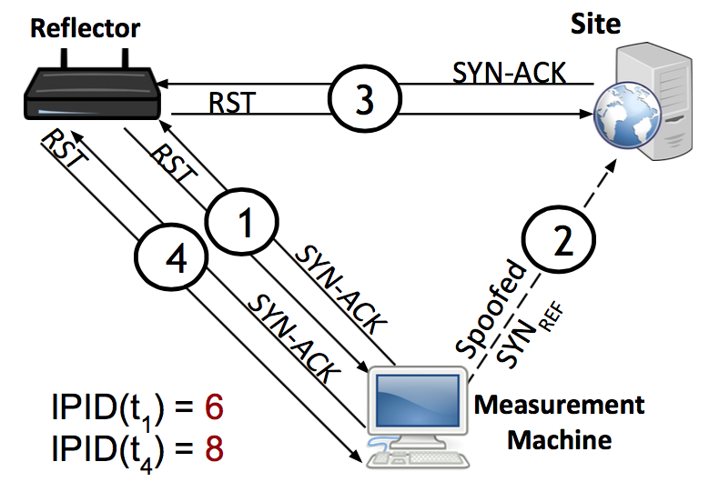
Augur Key Observation: IP ID Increment
Global IP ID for reflector
Increments for each packet sent
We can perturb this counter from a remote location
Continually probe reflector for IP ID value
Spoof packets from the measurement machine
Appear to come from reflector
Behavior under “normal” reachability
Notes:
The strategy behind our method is to leverage the fact that when an Internet host generates and sends IP packets, each generated packet contains a 16-bit IP identifier (“IP ID”) value that is intended to assist endpoints in re-assembling fragmented IPv4 packets.

Slide 132






Augur Requirements
Site
Open port and retransmitting SYN-ACKs
“User” (Reflector)
Must maintain a global value for IP ID
Measurement Machine
Must be able to spoof packets
Notes:
For spooky scan, the user doesn't need to be end user so we adopt the word reflect from now on.
The reflector must maintain a single global counter to generate IPID values regardless of destination IPs. The value of this counter at anytime reflects how many packets it has generated.
These requirements are very easy to satisfy.

Slide 133

No Blocking
Augur
Probe [IP ID: 7003]
No direction blocked
6
SYN/ACK
7
RST [IP ID: 7002]
Reflector IP ID:
7000
7001
7002
7003
1
SYN/ACK
2
RST [IP ID: 7000]
Measurement machine
3
Reflector
Spoofed SYN [src: Reflector IP]
RST [IP ID: 7001]
SYN/ACK
5
4
Site

Slide 134
Reflector-to-Site Blocked
6
SYN/ACK
7
RST [IP ID: 7002]
1
SYN/ACK
Reflector IP ID:
7000
7001
7002
2
RST [IP ID: 7000]
Measurement machine
3
5
RST
Spoofed SYN [src: ClientIP]
SYN/ACK
4
Site
Notes:
We can get a sample of IP ID.

Slide 135
Reflector-to-Site Blocked
Probe [IP ID: 7004]
Reflector IP ID:
7000
7001
7002
7003 7004
6
SYN/ACK
7
RST [IP ID: 7002]
1
SYN/ACK
2
RST [IP ID: 7000]
Measurement machine
3
5
RST
Spoofed SYN [src: ClientIP]
SYN/ACK
4
Site
Notes:
We can get a sample of IP ID.

Slide 136
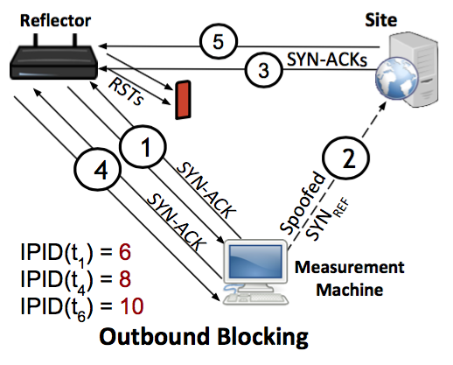
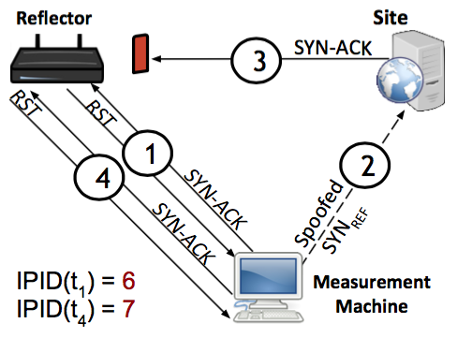
Summary: Behavior Under Blocking
Reflector to Site Blocked
Site to Reflector Blocked

Slide 137
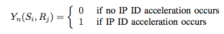
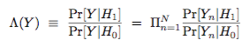
Statistical Detection: Max Likelihood
Random variable: IP ID acceleration
Detect the presence or absence of a prior (in this case, our perturbation), based on the separation of distributions of values under the prior.
Detection framework: Statistical Hypothesis Testing
Assumptions: IP ID acceleration is stationary, i.i.d.
Randomization of trail order, run trials over a course of weeks
Likelihood ratio:

Slide 138
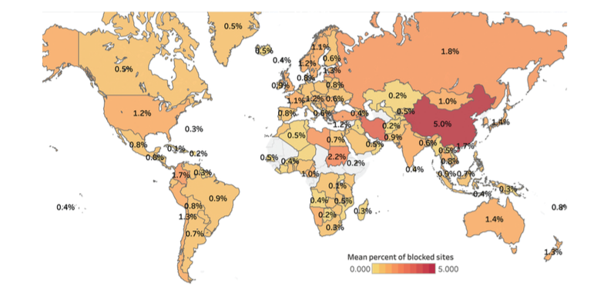
Pearce, Paul, et al. "Augur: Internet-Wide Detection of Connectivity Disruptions." Security and Privacy (SP), 2017 IEEE Symposium on. IEEE, 2017.
Notes:
Global heat map showing the percentage of sites filtered for any client in countries around the world. China experiences the highest average amount of filtering, at 5% of measurable sites filtered by a resolver within the country.

Slide 139
DNS Overview: Mapping Names to Addresses
www.cs.princeton.edu
root, .edu
www.cs.princeton.edu
NS dns.princeton.edu
NS dns1.cs.princeton.edu
dns.princeton.edu
Client
Local
DNS resolver
A 128.112.136.35
Recursive query
dns1.cs.princeton.edu
Iterative queries
DNS is not secured! Possible for manipulation attacks to occur.

Slide 140
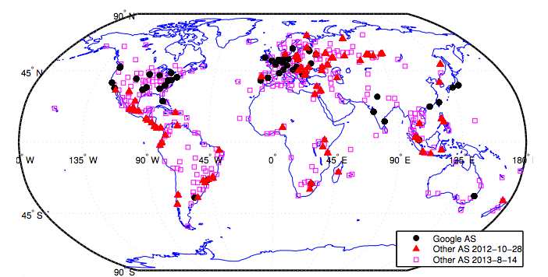
Detecting DNS Manipulation
Strawman: Find instances where the IP address returned does not agree with the “right answer”.
Problem: There is not a single right answer…
Extreme example: IP addresses returned for google.com (Katz-Bassett et al.)
Pearce, Paul, et al. "Global Measurement of DNS Manipulation." 26th {USENIX} Security Symposium ({USENIX} Security 17). USENIX} Association, 2017.

Slide 141
Consistency Metrics
IP Address
Autonomous System (“ISP”)
HTTP Content returned
Consistency of HTTPS certificate
Reverse DNS lookup (IP address to name)

Slide 142
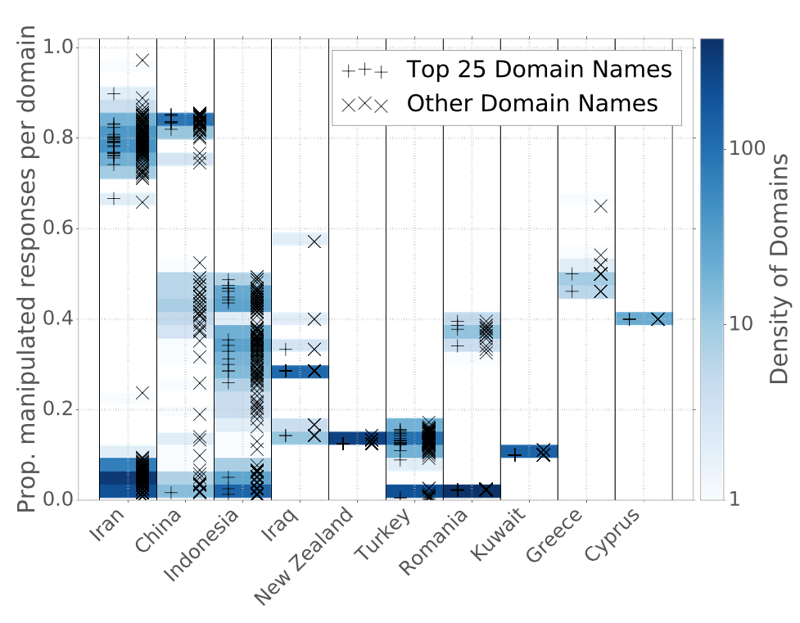
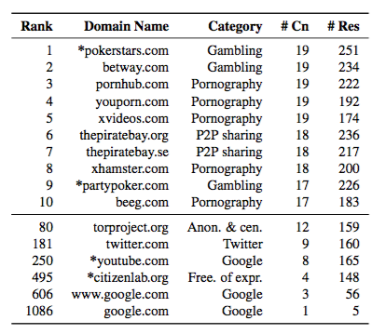
Manipulation of Domains within Countries
Notes:
----- Meeting Notes (4/14/17 13:50) -----
Need a version of this plot by category.

